Slide 1
Sprint Review
Sprint 1: Webscraping NFL Depth Chart Using RStudio (rvest)
Notes:
The objective of this first project was to create a code script to retrieve football player names and positions from an online NFL depth chart. This is part of a larger project in which my goal is to eventually have a product that automatically projects weekly Fantasy Football player points.

Slide 2
Notes:
I basically broke this first sprint down into three steps based on the software I was using/learning.
First part of my project involved a lot of HTML and CSS, the second part involved a lot of Rstudio, and third part of my involved a lot of Excel.

Slide 3
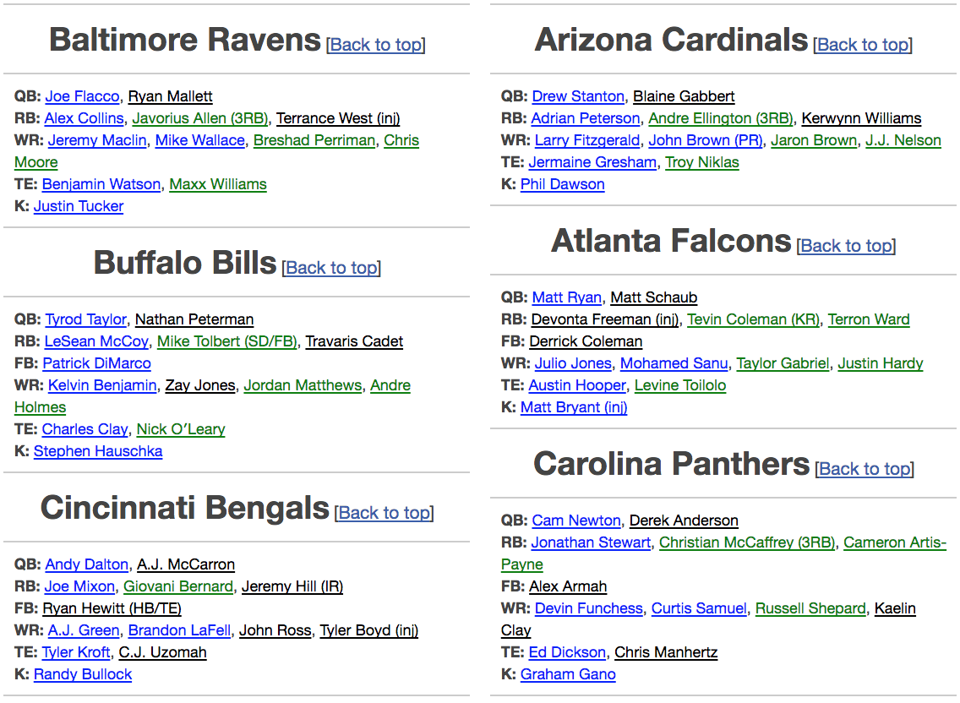
http://subscribers.footballguys.com/apps/depthchart.php?type=noidp&lite=yes&exclude_coaches=yes
Notes:
I found this website called footballguys.com and they had what looked like a relatively straightforward depth chart. Little did I know how many tables they had within their tables, and basically im a noob and it got pretty messy... But I digress

Slide 4
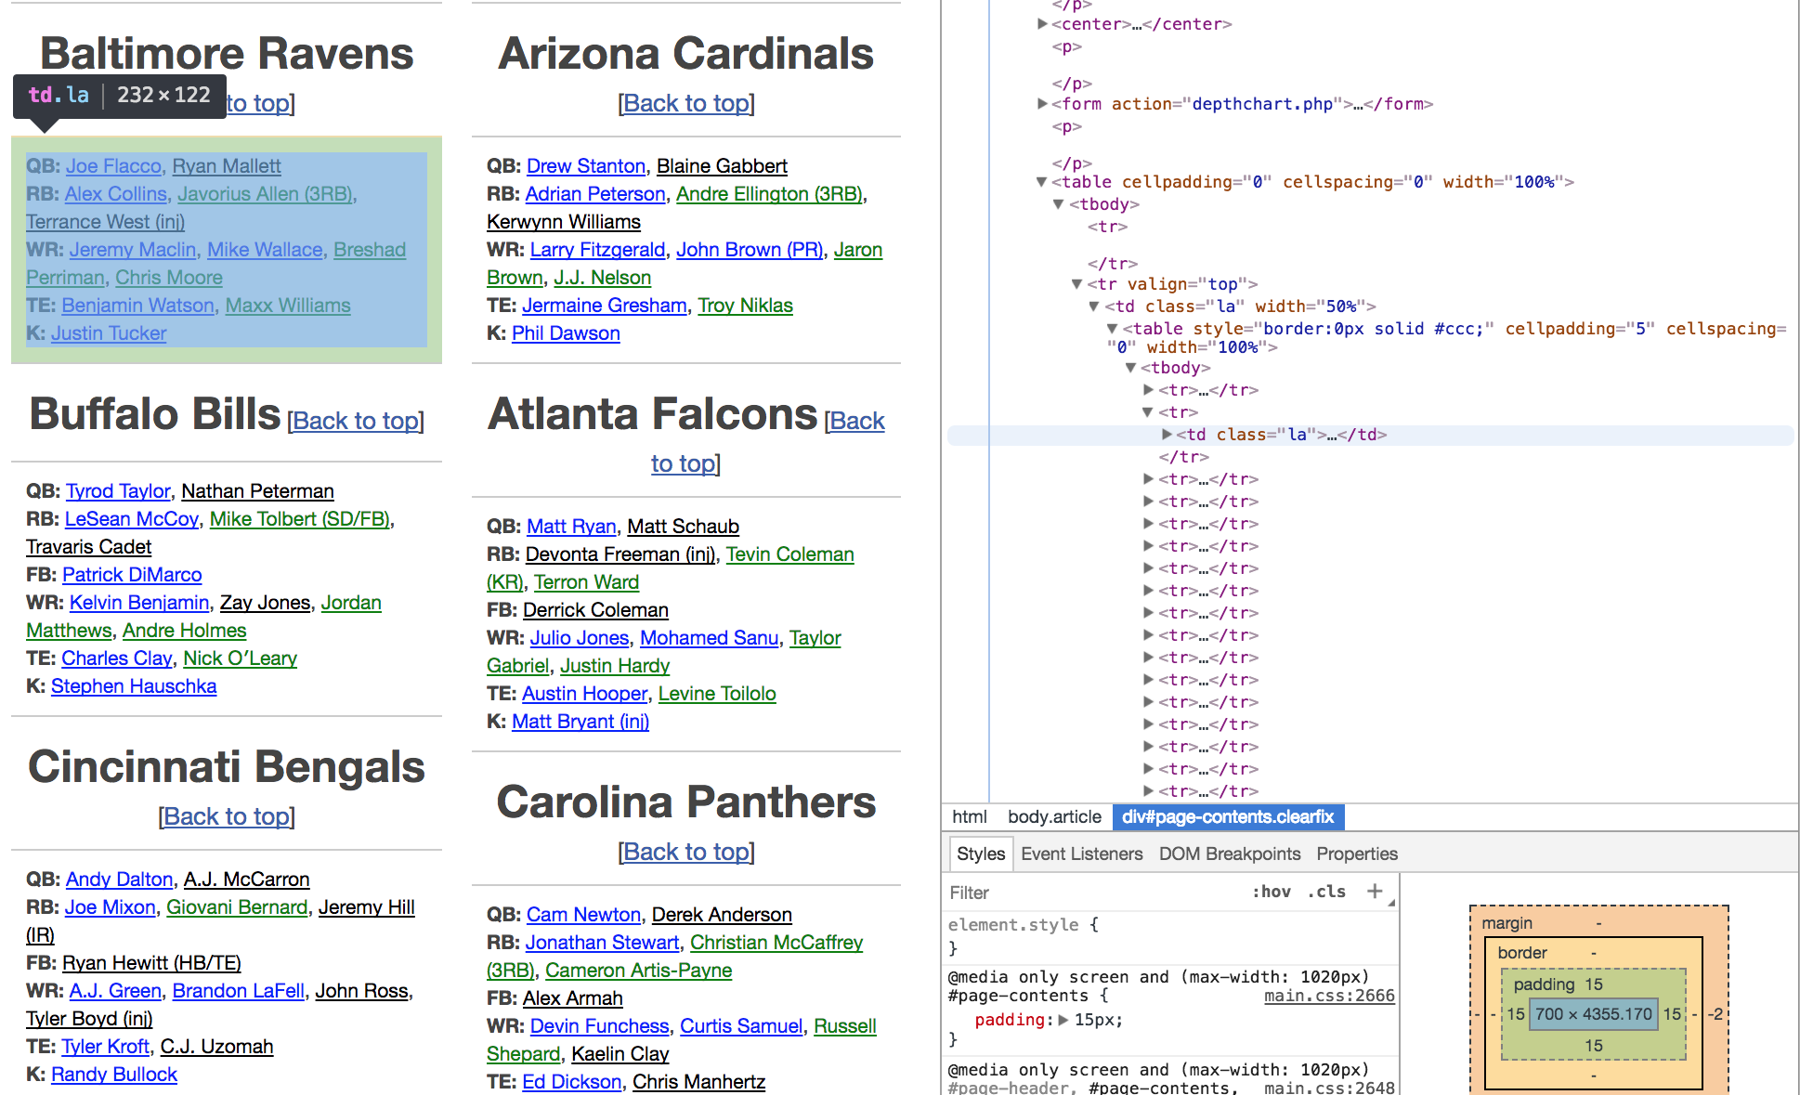
Notes:
Next, you can right click, select “inspect, and thatll open this developer panel here on the right side.
Click on the "Selector" tool on the top left to inspect a selected element on the HTML page
The section of the table I have selected of the class td, tag .la.
So right click again, and the option I chose was “copy xpath”

Slide 5
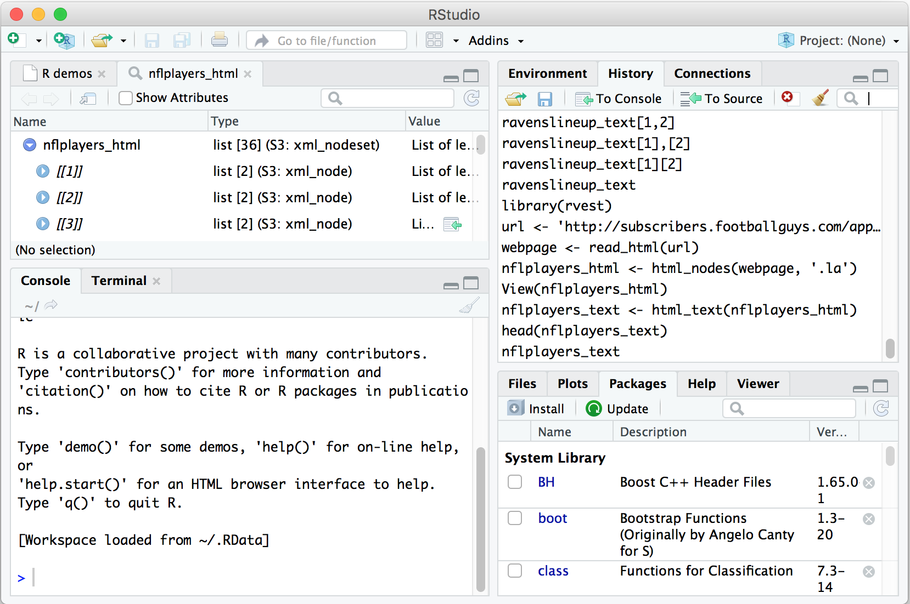
Notes:
The next part is Rstudio.
To use Rstudio, you type code stuff into this console on the bottom left.
For scraping data from HTML sites, justin suggested I installed a package within rstudio called rvest. I have the code on the next page, but you could also click packages over here, search it, and install it that way.

Slide 6
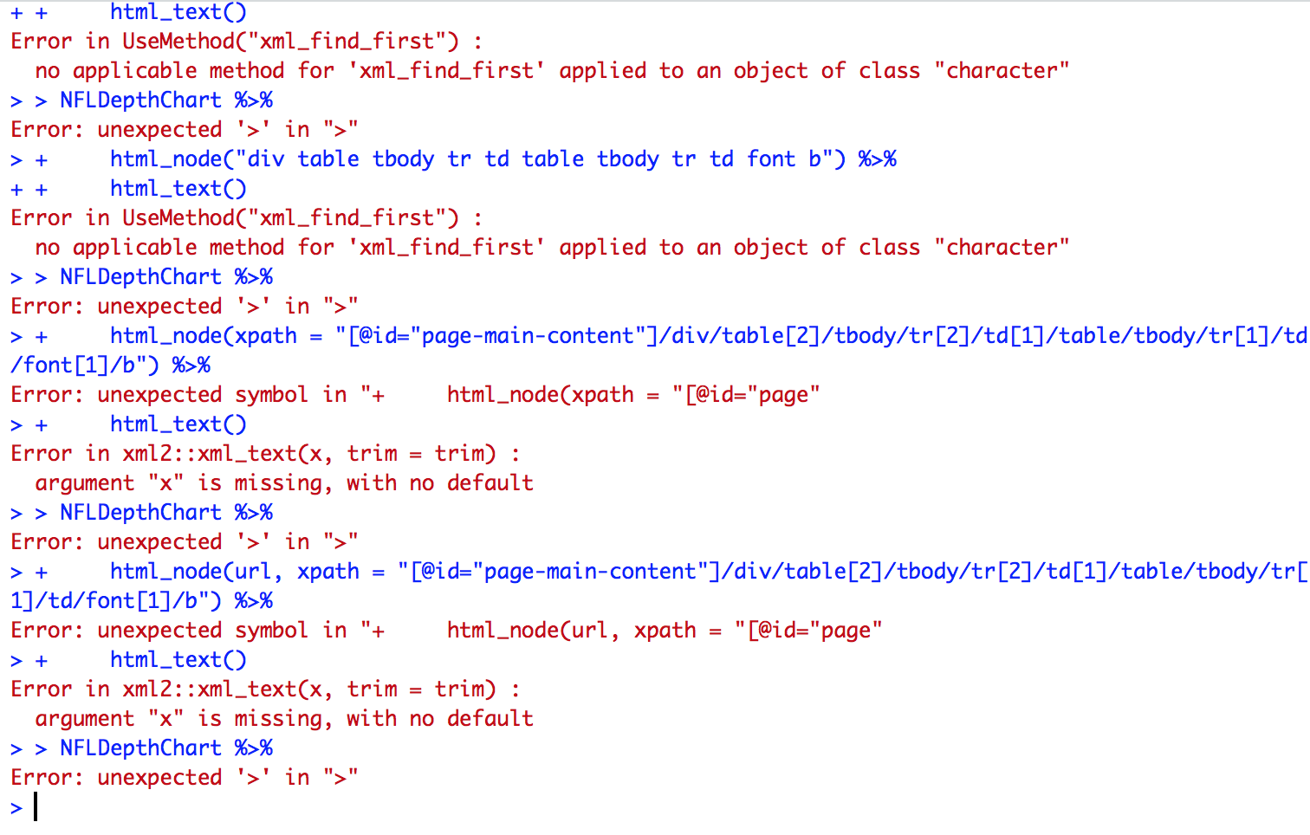
Notes:
This is what my Rstudio console looked like throughout most of class… Soo… Were gonna take the rest of these 20 seconds to take a moment of silence in remembrance of all those countless lost hours that selflessly sacrificed themselves for this cause.

Slide 7
> install.packages("rvest")
> library(rvest) > url <- 'http://subscribers.footballguys.com/apps/depthchart.php?type=noidp&lite=yes&exclude_coaches=yes’
> webpage <- read_html(url)
> nflplayers_html <- html_nodes(webpage, '.la')
> nflplayers_text <- html_text(nflplayers_html)
> nflplayers_text
Notes:
This is the final code I came up with.
- *install.packages("rvest")*
Installs rvest
*library(rvest)*
Loads the rvest package.
*url <- 'http://subscribers.footballguys.com/apps/depthchart.php?type=noidp&lite=yes&exclude_coaches=yes'*
Associates "url" with the website to be scraped.
*webpage <- read_html(url)*
Reads the HTML code from the specified website.
*nflplayers_html <- html_nodes(webpage, '.la')*
Uses the CSS selectors to scrape the sections with class ".la"
*nflplayers_text <- html_text(nflplayers_html)*
- Converts the HTML data into text format.
*nflplayers_text*
Displays data.

Slide 8
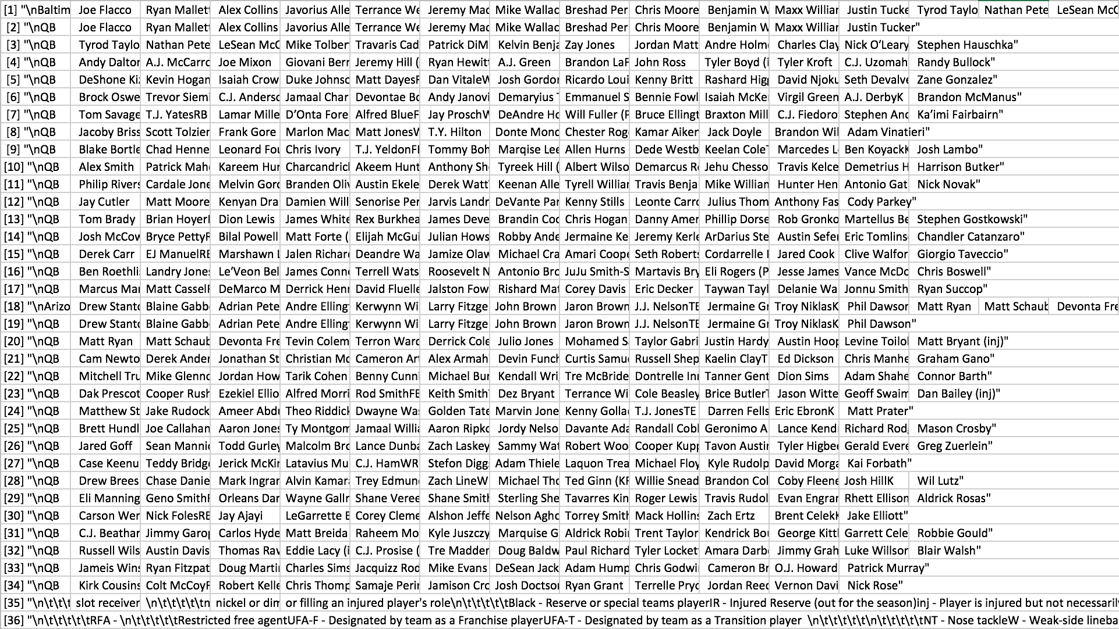
Notes:
For the data that Rstudio returned to me from the Depth Chart website, I copied and pasted it into excel, and this is how it was originally formatted. As you can see, the code from Rstudio returned 36 lines of data.
If you look through it, you eventually realize that the original HTML coding on the website is a little funny and it duplicates some of the data, and it also includes some extra information that wasnt useful to me, so the next step was to clean and format my data.

Slide 9
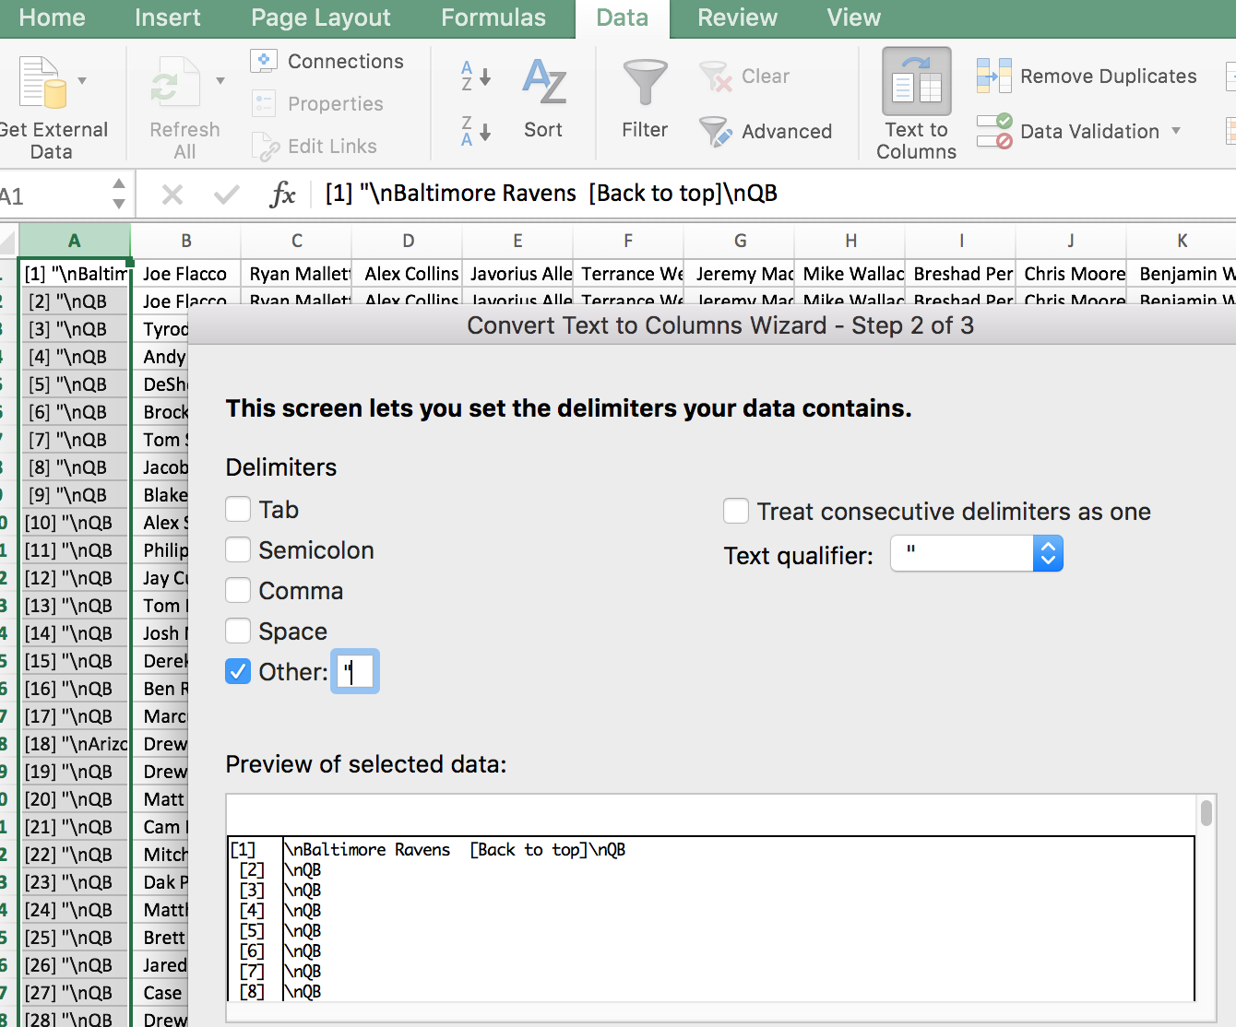
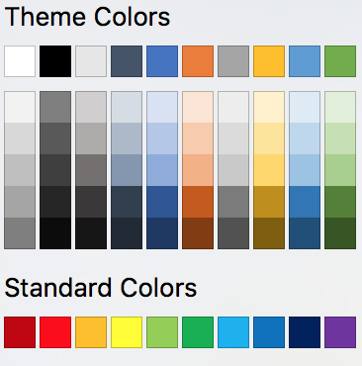
=LEFT(CELL#, LEN(CELL#)-2)
Notes:
To clean the data, I deleted some unnecessary rows, deleted some unnecessary positions, I used the text to column delimiter to separate some data into columns, and also had to clean some up with this function.
As far as formatting, it was mostly just adding headers and playing with cell and border colors.
Clean data
Delete unnecessary rows (1, 18, 35, and 36)
Delete unnecessary positions (FB)
Data > Text to Columns
Separate player names from positions (=LEFT(CELL#, LEN(CELL#)-2))
Format data
Add headers (Position Type + Position Number, e.g. RB1, WR3, TE2, etc. )
Change color of headers and columns separating player positions (dark blue)
Add color to cells with players depending on if they are in starting positions or not (light blue, light gray)
Change border colors (white)
Add conditional formatting to identify injured players (Text that contains "(inj)")

Slide 10
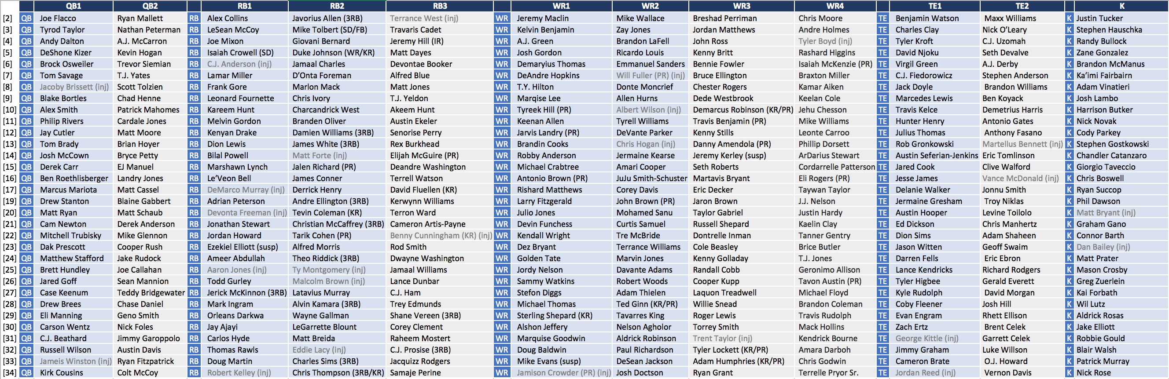
Notes:
And, this is what the final product looked like! Each row represents a team, and each column represents a position. The light blue cells represent players that would, at least in the league im playing in at work, be considered starting players, and the gray cells represents players that would be benched. And also I added some conditional formatting that says if a player is injured, it should show up in gray.

Slide 11
Thoughts…
Notes:
So that’s basically what I did the past few days… If I had more time, the biggest thing I would have liked to have done is to have found a way to export the data from Rstudio into a CSV or JSON file through code instead of copying and pasting it... Other than that, I definitely learned a lot and I think itll be very useful.

Slide 12
Fin

